Slide 1


JSPM’s
Bhivarabai Sawant Institute of Technology & Research Accredited with ‘B++’ Grade by NAAC
Department of Computer Engineering
Project Review - I on “Abstractive Document Summarization using Machine Learning Approach”
Presented By :
Mr. Mayur Kardile
Mr. Purushottam Nimje
Ms. Anuja Parve
Mr. Pratik Bachche
Guided By : Prof. Kanchan Pradhan

Slide 2
Content
Introduction
Problem Statement
Project Motivation
Literature Survey
Proposed System
Research Gap as per Review
Objectives
System Architecture
Data Flow Diagram
UML Diagram
Hardware & Software Requirement
Test Cases
Result
Conclusion

Slide 3
Introduction
This thesis aims to replicate and extend of knowledge on automatic text summarising.
The focus of study has been on developing frameworks for short, single-document summarising, rather than extended and multi-document summarization.
The ultimate goal of this topic is to provide a framework that can produce high-quality summaries regardless of the length of the source documents, whether it's a single or multi-document assignment, and irrespective of domain or language.
Given the recent impressive progress in short document summarising, the next challenge will be to reproduce the results using longer documents.

Slide 4
Introduction
The goal of this thesis is to contribute to the knowledge of expertise in the field of long document summary.
The evaluation of summaries and systems for Abstractive document summarising are two particularly relevant areas that we identify as core issues in this thesis.

Slide 5
Problem Statement
Our technique utilises of the document's discourse structure and analyses sentence similarity to split the challenge down into smaller summary difficulties.
We break down a long document and its summary into numerous source-target pairs, which are then used to train a model that learns to sum up each section of the abstractive document separately. After then, the partial summaries are integrated to provide a final complete summary.

Slide 6
Project Motivation
Summarization is intertwined with data compression and information comprehension, both of which are essential for information science and retrieval.
The ability to create informative and well-written document summaries has the potential to increase the success of both information discovery technologies and human users who are seeking to swiftly scan vast amounts of papers for significant information.
Indeed, automatic summarization has recently been acknowledged as one of the most significant natural language processing (NLP) jobs, despite the fact that it is also one of the least solved.

Slide 7
Literature Survey
Sr. No. | Paper Name | Authors | Publication Year | Conclusion
01 | Extractive Text Summarization Using Sentence Ranking | J.N.Madhuri, Ganesh Kumar.R | 2019 | In this paper, a novel statistical method to perform an extractive text summarization on single document is demonstrated. The method extraction of sentences, which gives the idea of the input text in a short form, is presented. Sentences are ranked by assigning weights and they are ranked based on their weights. Highly ranked sentences are extracted from the input document so it extracts important sentences which directs to a high-quality summary of the input document and store summary as audio.

Slide 8
Literature Survey
Sr. No. | Paper Name | Authors | Publication Year | Conclusion
02 | Multi-document Summarization by using Text Rank and Maximal Marginal Relevance for Text in Bahasa Indonesia | Dani Gunawan, Siti Hazizah Harahap, Romi Fadillah Rahmat | 2019 | In order to accomplish the objective, this research uses the combination of several online news articles, divided into six groups. The combined articles are pre-processed to produce a clean text. After obtaining the clean text, this research utilizes the Text Rank algorithm to extract the important sentences by using the similarity measurement. This process yields the summarized text.

Slide 9
Literature Survey
Sr. No. | Paper Name | Authors | Publication Year | Conclusion
03 | Automatic Text Summarization by Local Scoring and Ranking for Improving Coherence | P.Krishnaveni, Dr.S.R. Balasundaram | 2017 | In this paper, a novel statistical method to perform an extractive text summarization on single document is demonstrated. The method extraction of sentences, which gives the idea of the input text in a short form, is presented. Sentences are ranked by assigning weights and they are ranked based on their weights. Highly ranked sentences are extracted from the input document so it extracts important sentences which directs to a high-quality summary of the input document and store summary as audio.

Slide 10
Proposed System
In proposed system, we analyse and generate document summary using machine learning technique.
First user import document into the text format in the system.
After that in the system we classify the text, into the document.
We used NLP Algorithm to find Sentiment analysis. We try to analyse all the documents and convert into the short summary.

Slide 11
Research gap as per review
In Existing system, they used RNNs and Transformers, LSTM and RUM.
In proposed system we have used ML Technique for the training we used NLP algorithm and analyse sentiments. It uses this system algorithm to classify and analyse documents then generate document summary.

Slide 12
Objectives
To generate summary within given time duration.
To search within given time duration.
To Analyse the Abstractive Document summarization using NLP algorithm.

Slide 13
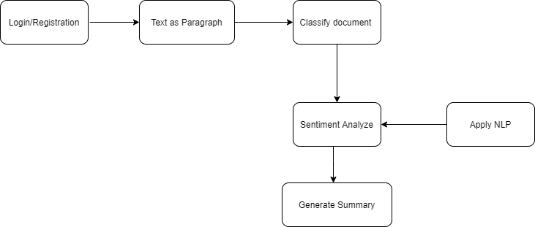
System Architecture Diagram

Slide 14

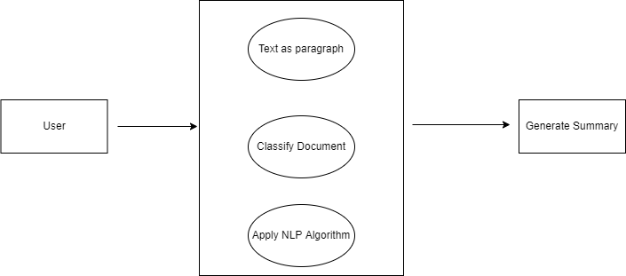
Data Flow Diagram
DFD0:
DFD1:

Slide 15
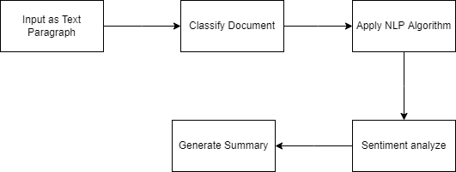
Data Flow Diagram
DFD2:

Slide 16
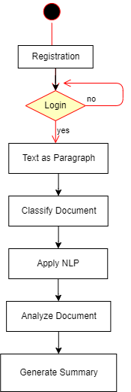
UML Diagram 1) USE Case Diagram

Slide 17
2) Activity Diagram

Slide 18
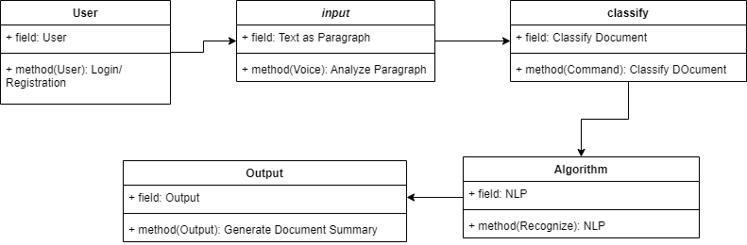
3) Class Diagram

Slide 19
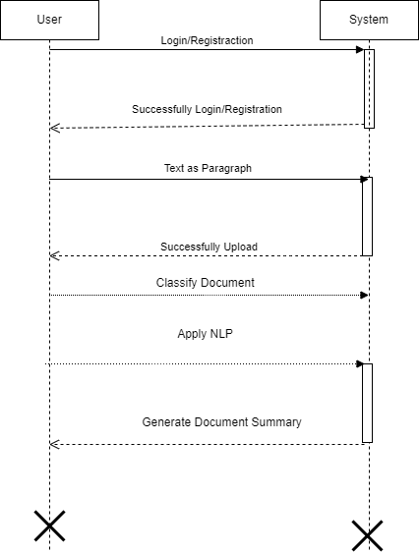
4) Sequence Diagram

Slide 20
Hardware and Software Requirement
Software Requirement:
Coding language: Python
IDE: Spyder
Database: Sqlite
Hardware Requirement:
No external hardware required.
Operating System:
Windows 10

Slide 21
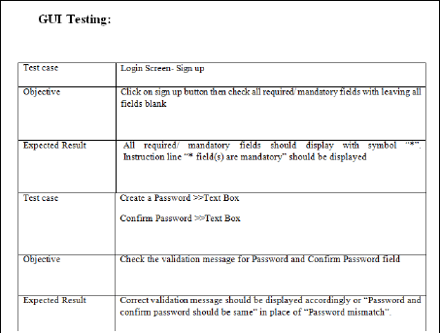
Test Cases

Slide 22
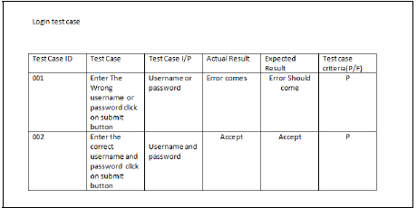
Test Cases

Slide 23
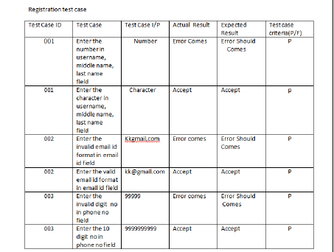
Test Cases

Slide 24
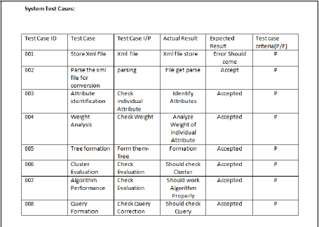
Test Cases

Slide 25

Result

Slide 26
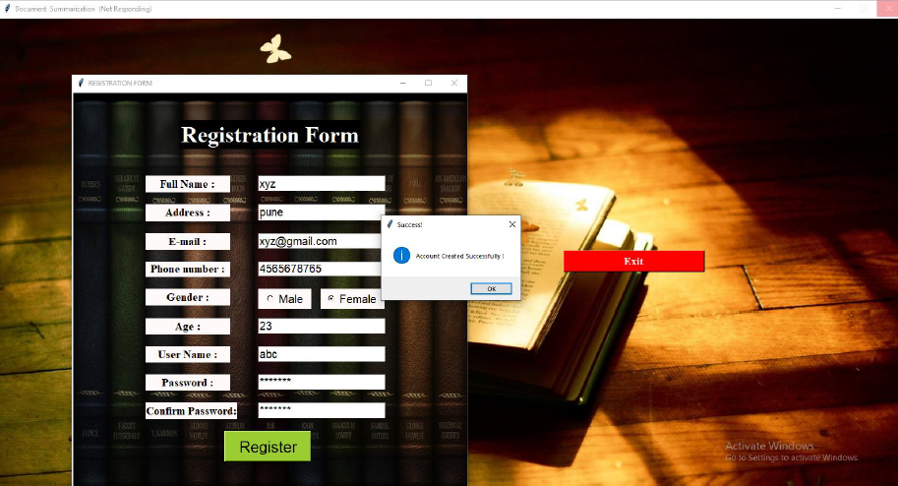
Result

Slide 27
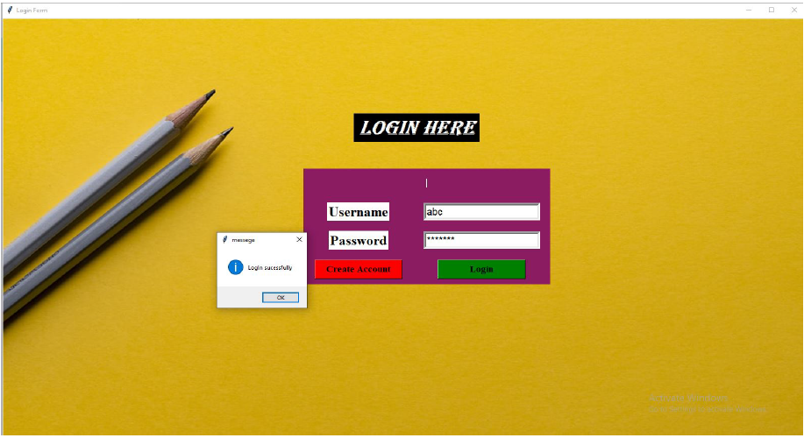
Result

Slide 28
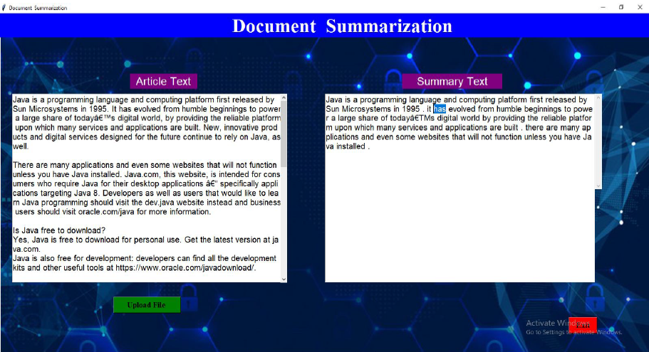
Result

Slide 29
Conclusion
Automatic Abstractive Document summarization is a complex task which contains many sub-tasks in it.
Every subtask has an ability to get good quality summaries.
The important part in abstractive document summarization is identifying necessary paragraphs from the given document. In this work we proposed abstractive based text summarization by using statistical novel approach based on the sentences ranking the sentences are selected by the summarizer.
The sentences which are abstractive are produced as a summarized text and it is converted into audio form.
The proposed model improves the accuracy when compared traditional approach.

Slide 30
…Thank You !!!

